Slide 1
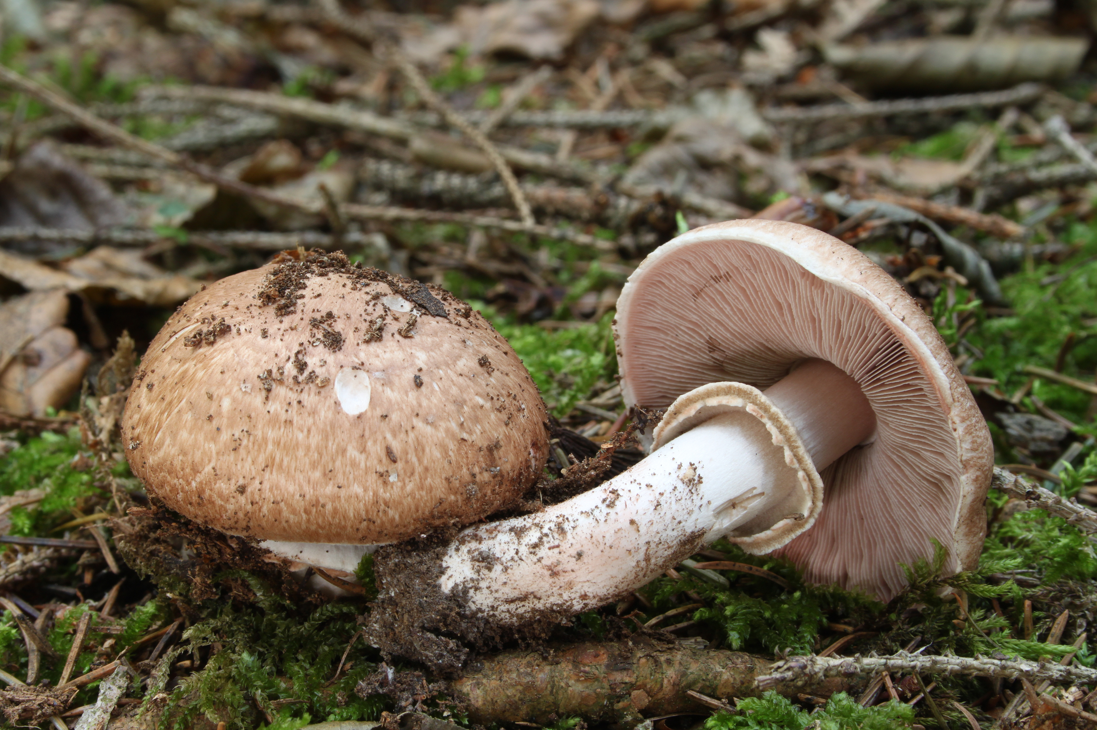
The Prediction of Mushroom Edibility Using Machine Learning
Benjamin W. Sturm
bwsturm@gmail.com
May 16, 2018
Notes:
My project was on the prediction of mushroom edibility using machine learning.

Slide 2

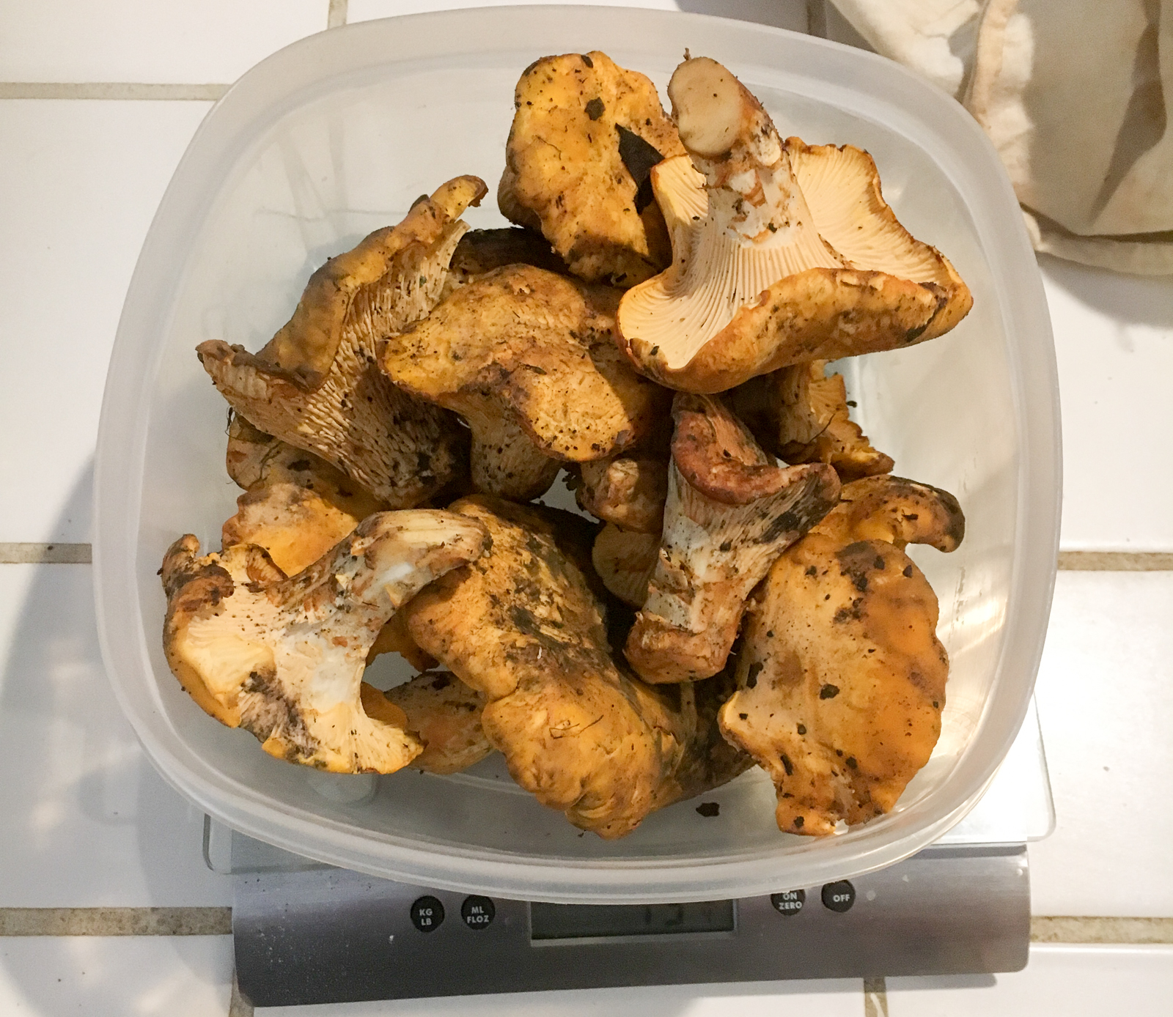
Hunting edible mushrooms in the wild can be an exciting and rewarding process
Hunter-Gatherers
The Trophy
Notes:
Hunting for edible mushrooms is something that I personally really like to do.
Click
Here is a picture of my son and I out on a recent mushroom hunting expedition.
Click
And here is a picture of our trophy. These are chanterelle mushrooms. Chanterelles are one of my favorite mushrooms to hunt for and they are easily identifiable and are also delicious.

Slide 3
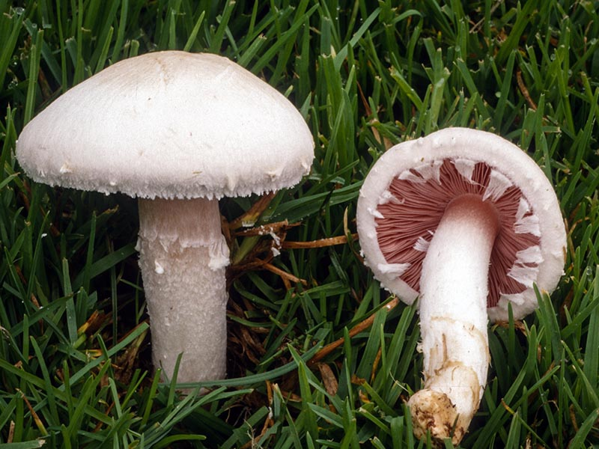
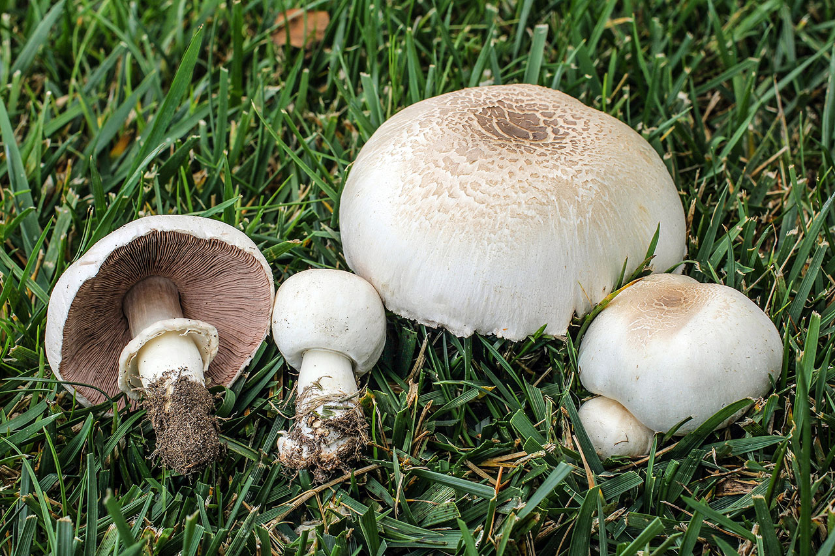
Wouldn’t it be great if you could determine whether a mushroom you encounter in nature is poisonous or not with machine learning?
Agaricus Campestris (Non-poisonous)
Agaricus Californicus (Poisonous)

Slide 4
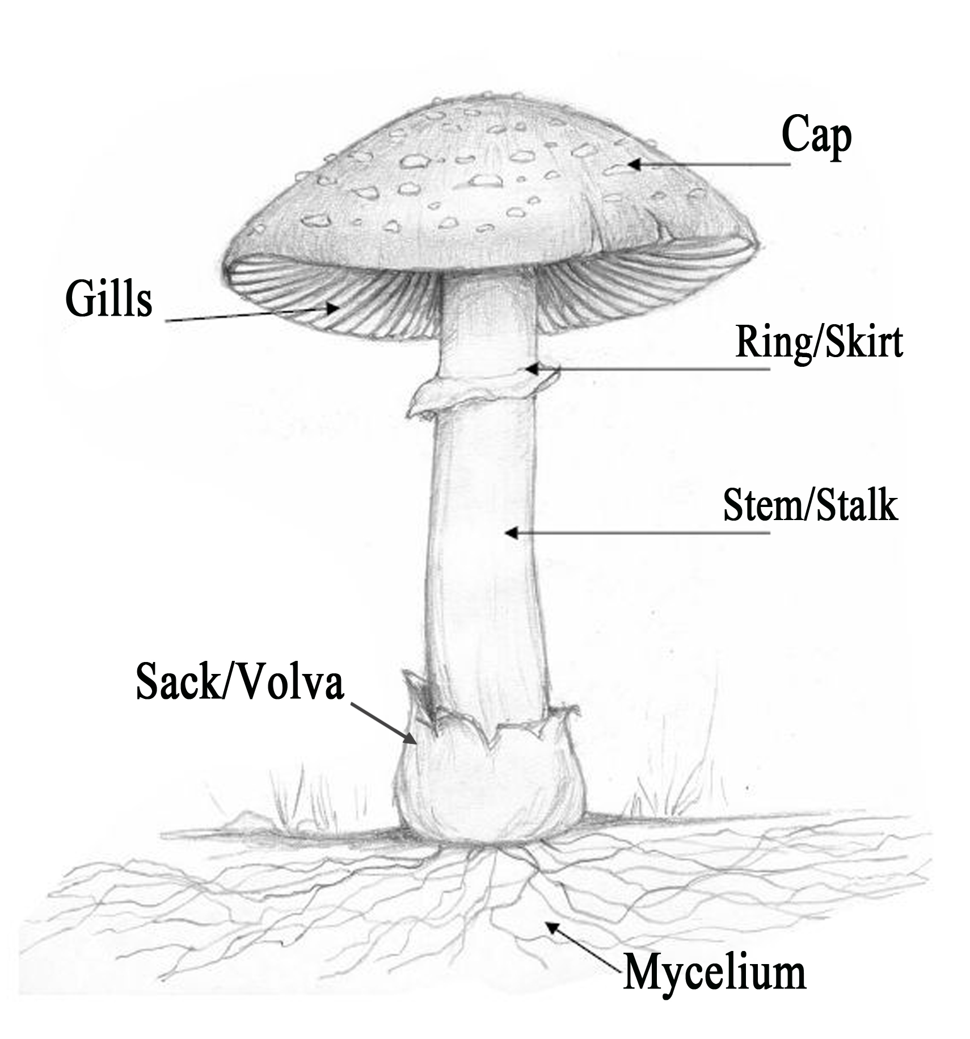
Wouldn’t it be great if you could determine whether a mushroom you encounter in nature is poisonous or not with machine learning?
 | Agaricus campestris (non-poisonous) | Agaricus californicus (poisonous)
cap color | white | whitish to brown
gill color | pink (young), chocolate brown (mature) | pink (young), chocolate brown (mature)
ring | no | yes
bruises? | no | yes
habitat | grass | forest and grass
odor | mild, mushroomy | antiseptic

Slide 5
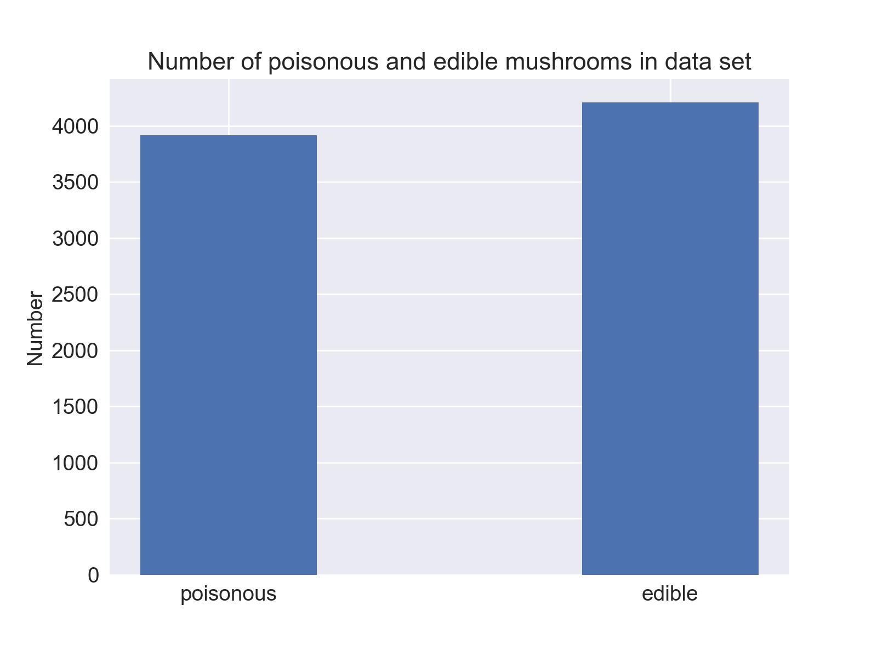
For this project, I used the UCI Mushroom Data Set to determine if machine learning could be used to classify the edibility of mushrooms
The data set consists of mushrooms from 2 different families only (Agaricus, Lepiota)
Number of instances = 8124
Number of features = 22
All features are categorical
Target variable is edibility
52% edible
48% non-edible

Slide 6
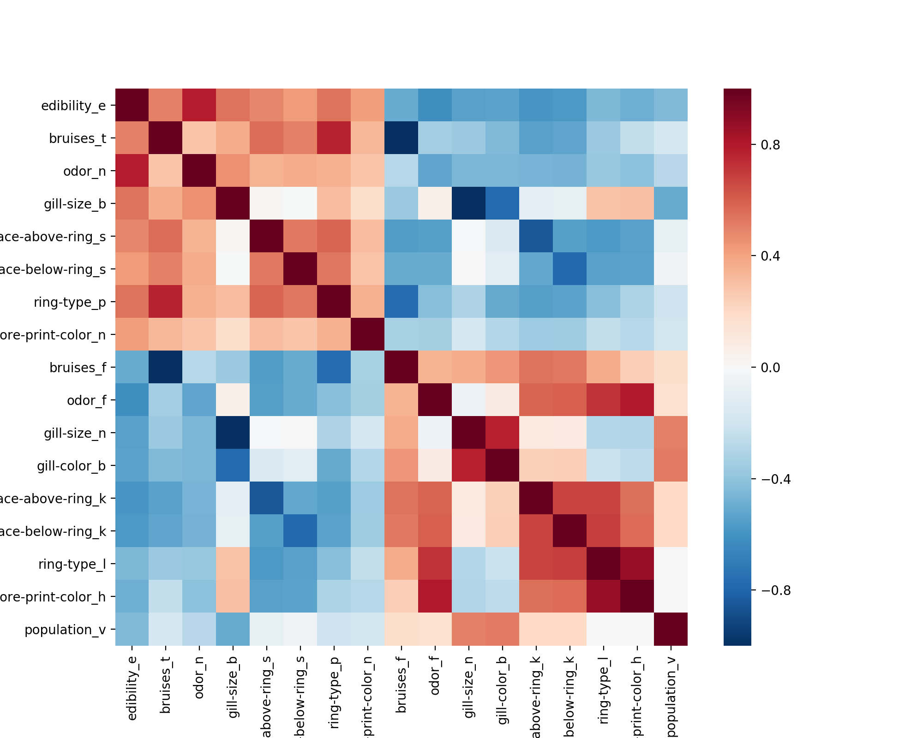
Certain features are strongly correlated with edibility
Corr = .786
Corr = -.624
Edibility
Odor - None
Odor - Foul

Slide 7
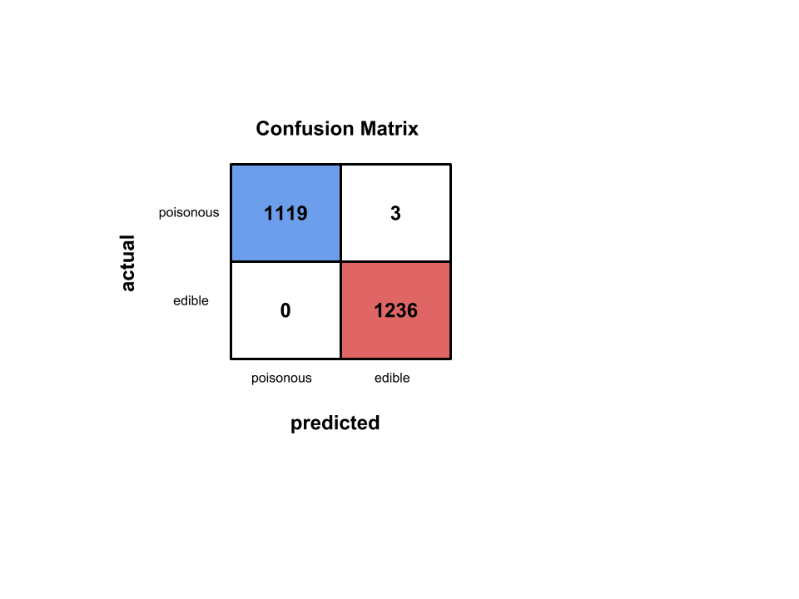
Baseline model using logistic regression has near perfect accuracy
Logistic Regression Results with default parameters
Model | Precision | Recall | Accuracy | AUC
Log. Reg. | 0.998 | 1.000 | 0.999 | 1.000

Slide 8
Which features are most important for predicting edibility?
Logistic regression important coefficients
For these 2 families of mushrooms, odor is one of the most important features
Odors indicating edibility
n = None, l = anise, a = almond
Odors indicating poisonous
p = pungent, f = foul, c = creosote
Also, don’t eat mushrooms in which the spore print is green
Feature | Beta
odor_n | 4.064
odor_l | 2.656
odor_a | 2.647
gill-size_b | 1.959
gill-spacing_c | -1.522
stalk-surface-above-ring_k | -1.665
gill-color_b | -1.799
gill-size_n | -2.067
odor_p | -2.253
stalk-root_b | -2.287
odor_f | -2.608
odor_c | -2.638
spore-print-color_r | -3.331
Predictive of
edibility
Predictive of
poisonous

Slide 9
Other models resulted in perfect accuracy
Model | Precision | Recall | Accuracy | AUC
Log. Reg. – L2 regularization | 0.998 | 1.000 | 0.999 | 1.000
Log. Reg. – L1 regularization | 0.996 | 1.000 | 0.998 | 1.000
KNN | 1.000 | 1.000 | 1.000 | 1.000
Decision Trees | 1.000 | 1.000 | 1.000 | 1.000

Slide 10
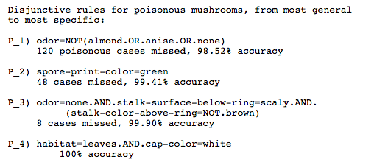
In conclusion, we were able to predict mushroom edibility with an accuracy of 1.000
Logistic Regression, KNN, and Decision Trees all did really well for this data set.
Mushroom odor was very predictive of edibility.
Data set is linearly separable.
Next steps:
Explore more mushroom species to see how well we can predict edibility for other mushroom types
See if we can correctly ID mushrooms based on these attributes
Explore using neural networks to classify mushrooms from photos
Notes:
A few caveats:
This data set consisted of 2 mushroom families in which odor plays a big role in identification.
The challenging part of mushroom identification is correctly identifying all of the attribute characteristics of your mushroom, which this data set has done for us.

Slide 11
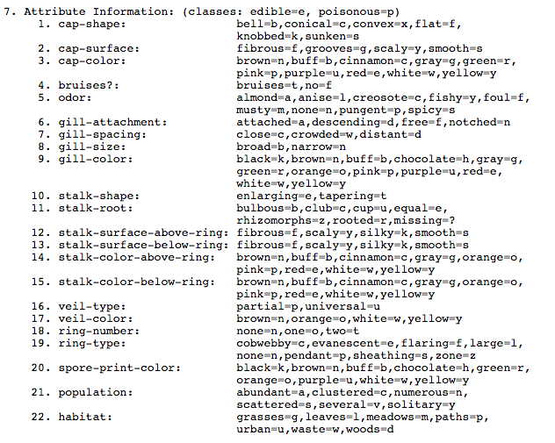
Appendix: Mushroom Attribute Information

